Slide 1
Mid Term Review
Data Management and Database Design
INFO 6210-01– Monday 6:00 PM – 9:30PM
Manuel Montrond

Slide 2
Mid Term Format
27 Questions
Section I: Multiple choices ( 12 questions)
Section II: Fill in the blank ( 5 questions)
Section III: Explanation ( 4 questions)
Section IV: Identify difference/similarities ( 4 questions)
Section V: Diagramming/Normalization ( 2 questions)
Pen and paper
1 page of handwritten cheat sheet (8.5X11 in) (front and back)
You will have 1 and a half hour

Slide 3
Exam Topics
Entity–Relationship Modeling
Enhanced E-R Modeling
Logical Database Design and the Relational Model
Data Normalization
Physical Database Design and Performance
Structure Query Language (SQL)
Data Definition Language
Data Manipulation Language

Slide 4
Chapter 1: The Database Environment and Development Process

Slide 5
Definitions
Database: organized collection of logically related data
Data: sored representations of meaningful objects and events
Structured: numbers, text, dates
Unstructured: images, video, documents
Information: data processed to increase knowledge in the person using the data
Metadata: data that describes the properties and context of user data
Notes:
Database: organized collection of logically related data – key word is related data which implies it is a database. Why Logical, not physical: doesn’t it have to be in the same data center?
Data: stored representations of meaningful objects and events - e.g. social media store posts, pictures etc.
Structured: numbers, text, dates
Unstructured: images, video, documents
Information: data processed to increase knowledge in the person using the data. The difference between data and information is that information increases knowledge.
Metadata: data that describes the properties and context of user data – or simply data about the data.

Slide 6
Advantages of the Database Approach
Program-data independence
Planned data redundancy
Improved data consistency
Improved data sharing
Increased application development productivity
Enforcement of standards
Improved data quality
Improved data accessibility and responsiveness
Reduced program maintenance
Improved decision support

Slide 7
Costs and Risks of the Database Approach
New, specialized personnel
Installation and management cost and complexity
Conversion costs
Need for explicit backup and recovery
Organizational conflict
Notes:
New, specialized personnel – need a DBA to perform the tasks
Installation and management cost and complexity
Conversion costs – not free
Need for explicit backup and recovery
Organizational conflict

Slide 8
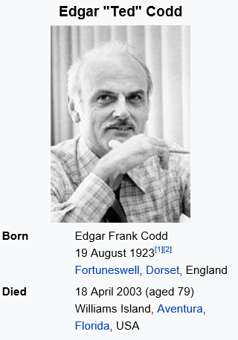
Founder of DBMS
Notes:
He first wrote a paper of managing data through RDMBS in 1970. He worked for IBM

Slide 9
Chapter 2: Data Modeling in the Organization

Slide 10
Business Rules
Are statements that define or constrain some aspect of the business
Are derived from policies, procedures, events, functions
Assert business structure
Control/influence business behavior
Are expressed in terms familiar to end users
Are automated through DBMS software
Notes:
As part of any organization, data model is a representation of a business. It is an expression of business rules!
To design good data models, we need good business rules expressed clearly
Are statements that define or constrain some aspect of the business -> if you are a pizza shop, one of your business rules may be: we only deliver within 5 miles radius of our location. Or we only deliver within our zip code
Are derived from policies, procedures, events, functions – in this example, that would be a company policy.
Assert business structure
Control/influence business behavior
Are expressed in terms familiar to end users
Are automated through DBMS software

Slide 11
A Good Business Rule Is:
Declarative–what, not how
Precise–clear, agreed-upon meaning
Atomic–one statement
Consistent–internally and externally
Expressible–structured, natural language
Distinct–non-redundant
Business-oriented–understood by business-people
Notes:
Declarative–what, not how -> drives must deliver only within 5-mile radius. Don’t have to mention they have to used GPS.
Precise–clear, agreed-upon meaning
Atomic–one statement
Consistent–internally and externally
Expressible–structured, natural language
Distinct–non-redundant
Business-oriented–understood by businesspeople
Examples of a business rules:
A car with more than 5k accumulated miles must be scheduled for service.
To obtain your degree you must have an average GPA of 3.0

Slide 12
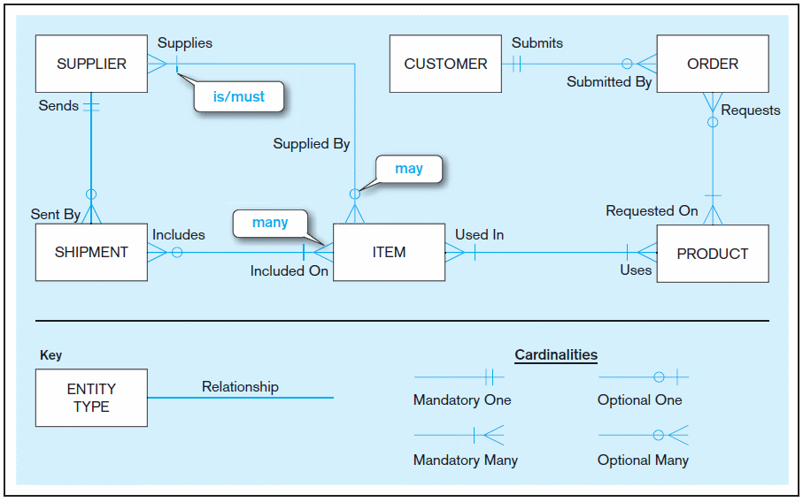
Sample E-R Diagram (Figure 2-1)
Notes:
3
You must know how to translate the diagram to English sentences.
Keep in mind the words “may” and “must” to denote optional or required.

Slide 13
Attributes
Attribute–property or characteristic of an entity or relationship type
Classifications of attributes:
Required versus Optional Attributes
Simple versus Composite Attribute
Single-Valued versus Multivalued Attribute
Stored versus Derived Attributes
Identifier Attributes
Notes:
5
Required versus Optional Attributes → first name is required, middle name is optimal
Simple versus Composite Attribute -> composite means more than one part.
Single-Valued versus Multivalued Attribute ( more than one row)
Stored versus Derived Attributes ( attribute that be derived from others. Age based on DOB)
Identifier Attributes ( keys, Student IDs, SS# etc)
Examples of Required versus Optional Attributes: Middle Name should be optional for students.
Simple versus Composite Attribute: Home Address is a composite Attribute with 3 parts! Person’s Name is a composite
Single-Valued versus Multivalued Attribute: Students and skills, you can have many skills
Stored versus Derived Attributes; DOB is stored attribute, age is derived attribute
Identifier Attributes: Student ID, SS# , VIN #

Slide 14
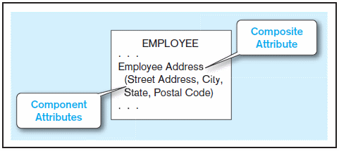
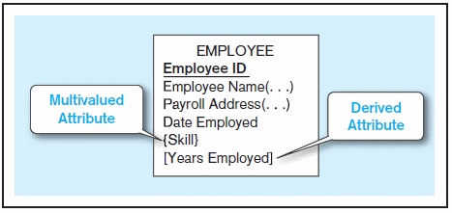
Figure 2-7 A composite attribute
An attribute broken into component parts
Figure 2-8 Entity with multivalued attribute (Skill)
and derived attribute (Years Employed)
Multivalued
an employee can have
more than one skill
Derived
from date employed and current date
Notes:
12
Difference between composite and multi-valued attribute

Slide 15
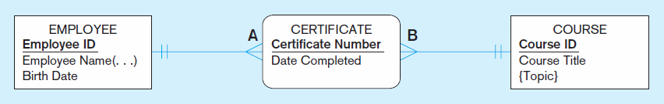
Figure 2-11b An associative entity (CERTIFICATE)
Associative entity is like a relationship with an attribute, but it is also considered to be an entity in its own right
Note that the many-to-many cardinality between entities in Figure 2-11a has been replaced by two one-to-many relationships with the associative entity
Notes:
21
There is a business expression for that relationship and an identifier

Slide 16
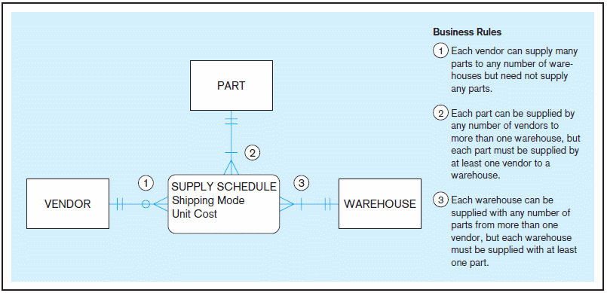
Figure 2-18 Cardinality constraints in a ternary relationship
Notes:
36
Understand situations in which an associative entity is created from a ternary relationship:
Notice that all entities are many-to-many

Slide 17
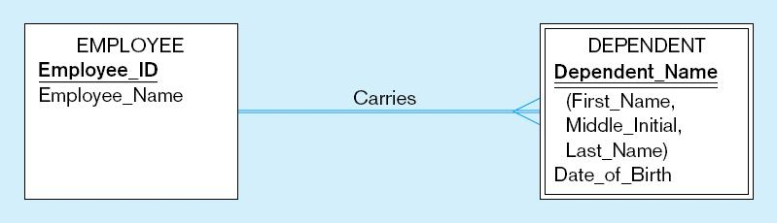
Identifying relationship (Figure 3-5)
Notes:
What type of entity is DEPENDENT? A) co-related entity, associative entity, week entity? What type of entity is employee

Slide 18
Chapter 3: Enhanced Data Modeling

Slide 19
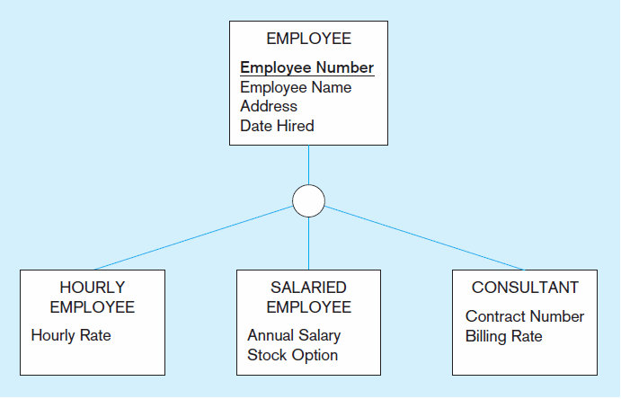
Figure 3-2 Employee supertype with three subtypes
All employee subtypes will have employee number, name, address, and date hired
Each employee subtype will also have its own attributes
Notes:
Given Business rules, draw E-R diagram
When to draw sub-type?

Slide 20
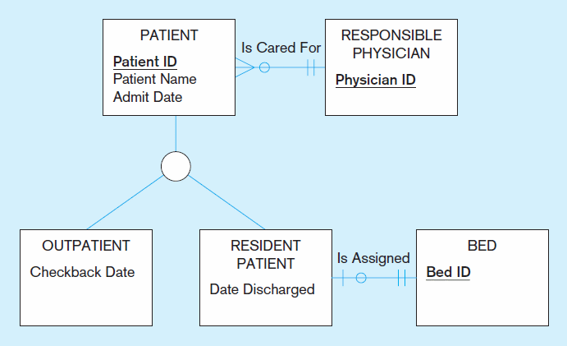
Figure 3-3 Supertype/subtype relationships in a hospital
Both outpatients and resident patients are cared for by a responsible physician
Only resident patients are assigned to a bed
Notes:
Both Residential and outpatient inherits the physician responsible

Slide 21
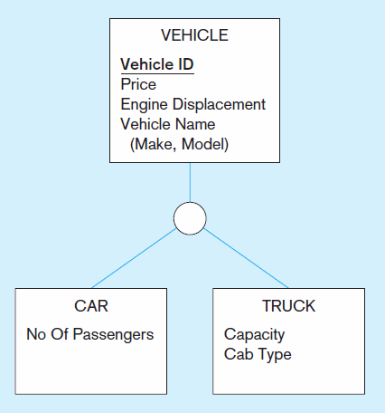
Figure 3-4 Example of generalization (cont.)
b) Generalization to VEHICLE supertype
So we put the shared attributes in a supertype
Note: no subtype for motorcycle, since it has no unique attributes
Notes:
Generalization -> bottom- up approach! Going from cars, generated to vehicle

Slide 22
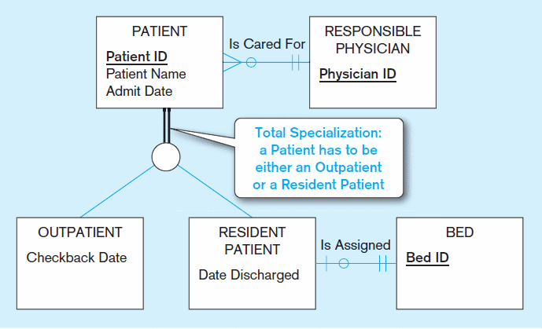
Figure 3-6 Examples of completeness constraints
a) Total specialization rule
Notes:
Q9
Completeness contains
Double line = Must exist in one of the subtype
Single Line = May or may not

Slide 23
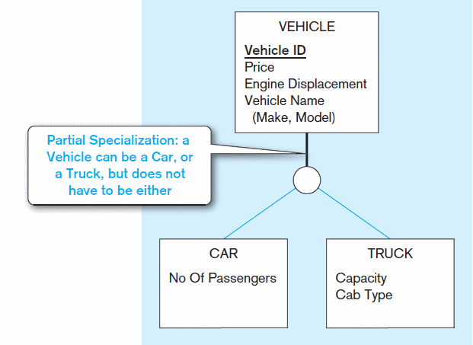
Figure 3-6 Examples of completeness constraints (cont.)
b) Partial specialization rule
Notes:
Q9

Slide 24
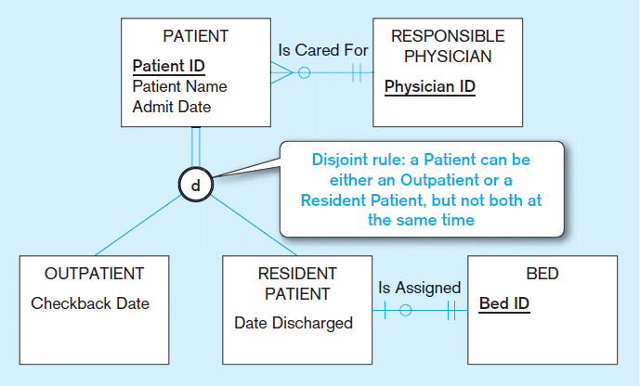
Figure 3-7 Examples of disjointness constraints
a) Disjoint rule
Notes:
Disjointness constraints
D = may be either one or the other, but not both

Slide 25
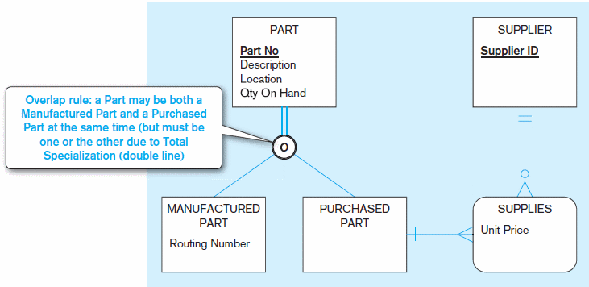
Figure 3-7 Examples of disjointness constraints (cont.)
b) Overlap rule
Notes:
Overlap -> self explanatory
A part may be one or the other, or both

Slide 26
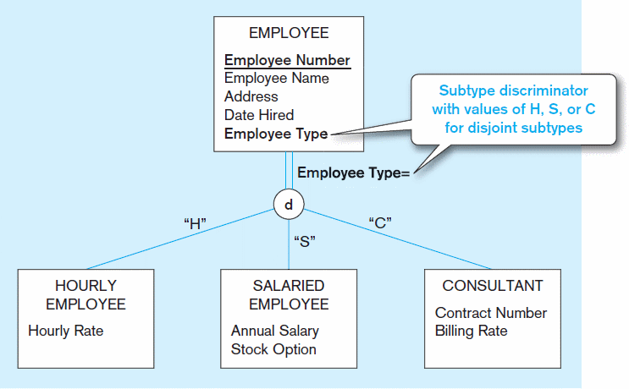
Figure 3-8 Introducing a subtype discriminator (disjoint rule)
Notes:
Subtype Discriminator = tells the model which subtype is used

Slide 27
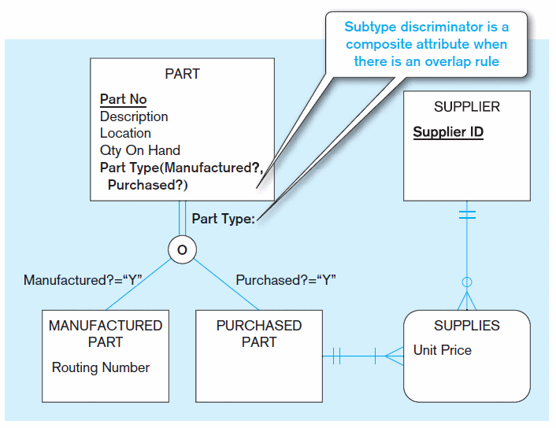
Figure 3-9 Subtype discriminator (overlap rule)
Notes:
Overlap discriminator with overlap -> implemented as Flags and as a composite attribute

Slide 28
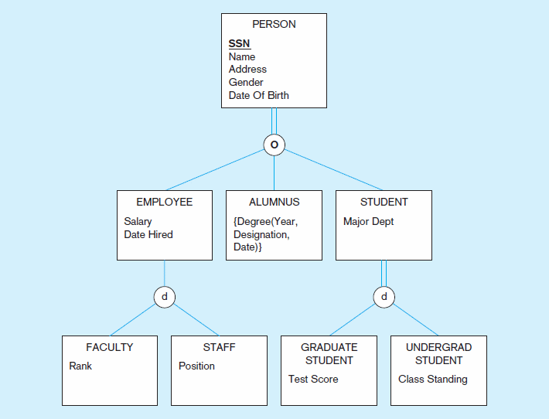
Figure 3-10 Example of supertype/subtype hierarchy
Notes:
There could be many levels of the hierarchy

Slide 29
Chapter 4: Logical Database Design and the Relational Model

Slide 30
Components of Relational Model
Data structure
Tables (relations), rows, columns
Data manipulation
Powerful S Q L operations for creating and modifying structures, for retrieving and modifying data
Data integrity
Mechanisms for implementing business rules that maintain integrity of manipulated data

Slide 31
Integrity Constraints
Domain Constraints
Allowable values for an attribute (includes data types and restrictions on values)
Entity Integrity
No primary key attribute may be null. All primary key fields MUST contain data values.
Referential Integrity
Rules that maintain consistency between the rows of two related tables.

Slide 32
Integrity Constraints
Referential Integrity–rule states that any foreign key value (on the relation of the many side) MUST match a primary key value in the relation of the one side. (Or the foreign key can be null)
For example: Delete Rules
Restrict–don’t allow delete of “employee” side if related rows exist in “dependent” side
Cascade–automatically delete “dependent” side rows that correspond with the “employee” side row to be deleted
Set-to-Null–set the foreign key in the dependent side to null if deleting from the parent side → not allowed for weak entities
Notes:
Draw Example of customer order
Integrity constraint enforces the primary key FK relationship.
When deleting, you can either restrict., cascade

Slide 33
Data Normalization
Primarily a tool to validate and improve a logical design so that it satisfies certain constraints that avoid unnecessary duplication of data
The process of decomposing relations with anomalies to produce smaller, well-structured relations
Notes:
Avoid data duplication -> it is a big problem at every company because data models often time are not properly design in many organizations.
Costs companies millions of dollars every year.
Well structure relations

Slide 34
Well-Structured Relations
A relation that contains minimal data redundancy and allows users to insert, delete, and update rows without causing data inconsistencies
Goal is to avoid anomalies
Insertion Anomaly–adding new rows forces user to create duplicate data
Deletion Anomaly–deleting rows may cause a loss of data that would be needed for other future rows
Modification Anomaly–changing data in a row forces changes to other rows because of duplication
General rule of thumb: A table should not pertain to more than one entity type
Notes:
Three anomalies to avoid:
Insertion Anomaly – creating duplicate records
Deletion Anomaly–deleting incorrect records, orphan records is an example of it
Modification Anomaly–force to change records multiple times. Think about change a customer name, should only be done once

Slide 35
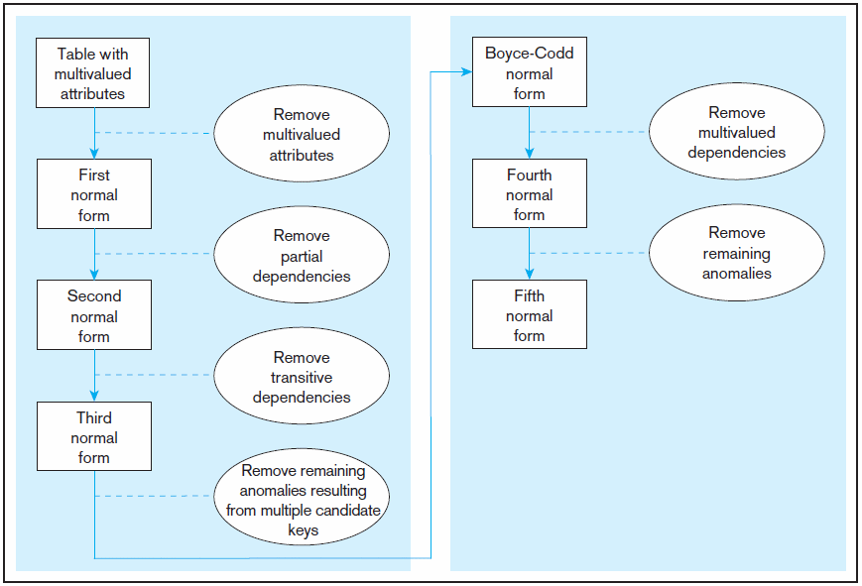
Figure 4.22 Steps in normalization
3rd normal form is generally considered sufficient
Notes:
Here are the steps to create normalizations:
1NF – remove multivalued attribute… Employee Skill for example
2NF – remove partial dependency
3NF – remove transitive dependencies
After 3NF it is typically not used. One interview question, you will often hear is “ Which Normal form do you normalize your database” The answer is third normal forms.

Slide 36
Rules for Indexes
Use on larger tables
Index the primary key of each table
Index search fields (fields frequently in WHERE clause)
Fields in SQL ORDER BY and GROUP BY commands

Slide 37
Chapter 5: Physical Database Design and Performance

Slide 38
Critical Decisions for Physical Design
Choosing the storage format (called data type) for each attribute from the logical data model
Giving the D B M S guidance regarding how to group attributes from the logical data model into physical records
Giving the D B M S guidance on how to arrange similarly structured records in secondary memory (file organization)
Selecting structures (including indexes and the overall database architecture) for storing and connecting files to make retrieving related data more efficient
Preparing strategies for handling queries against the database that will optimize performance (query optimization)
Notes:
The primary goal of physical database design is data processing efficiency.
The organizational role that typically has the primary responsibility for physical database design is called the database administrator (DBA). More about database administration in Chapter 12.

Slide 39
Choosing Data Types
CHAR–fixed-length character
VARCHAR–variable-length character (memo)
LONG–large number
NUMBER–positive/negative number
INTEGER–positive/negative whole number
DATE–actual date
BLOB–binary large object (good for graphics, sound clips, etc.)
Notes:
Below are examples of data types
What data type would you choose for FirstName,
What type of data type would you choose for student ID?
What type of datatype would you choose a song?

Slide 40
Field Data Integrity
Default value–assumed value if no explicit value
Range control–allowable value limitations (constraints or validation rules)
Null value control–allowing or prohibiting empty fields
Referential integrity–range control (and null value allowances) for foreign-key to primary-key match-ups
Notes:
How do you ensure only the data types that you want are stored in your tables?
Default value– when not provided by users, it is defaulted to a specific value.
Range control–allowable value limitations - maybe you only allow a score from 0-5.
Null value control–allowing or prohibiting empty fields. Required field vs. non-required field
Referential integrity–range control (and null value allowances) for foreign-key to primary-key match-ups.

Slide 41
Designing Physical Database Files
Physical File
A named portion of secondary memory allocated for the purpose of storing physical records
Tablespace – named logical storage unit in which data from multiple tables/views/objects can be stored
Tablespace components
Segment – a table, index, or partition
Extent – contiguous section of disk space
Data block – smallest unit of storage
Notes:
We’ve been talking about relational database structures, involving tables, columns, and primary and foreign keys, as if this is in fact the way data is stored on disk. But it is not. At the operating system level, we are always talking about files. Databases are just one kind of file. The table/column/key idea is really an abstraction. At a lower implementation level, these database files (like all physical files) are constructed via different file formats, which will be discussed in the next few slides.
Most database management systems store many kinds of data in one operating system file. By an operating system file, we mean a named file that would appear on a disk directory listing (e.g., a listing of the files in a folder on the C: drive of your personal computer).

Slide 42
File Organizations
Types of file organizations
Heap – no order
Sequential
Indexed
Hashed
Factors for selecting file organization
Fast data retrieval and throughput
Efficient storage space utilization
Protection from failure and data loss
Minimizing need for reorganization
Accommodating growth
Security from unauthorized use
Notes:
A file organization is a technique for physically arranging the records of a file on secondary storage devices. Typical file organizations include sequential, indexed, and hashed, which we will see in the next few slides. Another possibility is something called a “heap”, but this has no order and is not ideal for quick access. Imagine a telephone book where people were in no particular order. You’d potentially have to search through each and every name before finding what you need. The other file organizations are designed to bring quick access and/or optimize insertion, modification, and removal of data items.
With modern relational DBMSs, you don’t need to design file organizations, but you may be allowed to select an organization and its parameters for a table or physical file. Here are some factors to consider.

Slide 43
Denormalization
Transforming normalized relations into non-normalized physical record specifications
Benefits:
Can improve performance (speed) by reducing number of table lookups (i.e. reduce number of necessary join queries)
Costs (due to data duplication)
Wasted storage space
Data integrity/consistency threats
Notes:
It might seem counterintuitive that a database designer would want to denormalize a previously normalized (well structured) set of relations. After all, we spent considerable effort towards conceptual modeling (E-R/ EER) in order to ensure well-structured logical design. And, when faced with poorly structured relations, we normalized them in our logical design. Why denormalize now?
The answer is performance. When you normalize, you split data into separate tables in order to eliminate or at least reduce data duplication. This helps to ensure data integrity. But, it comes at a cost. It is much more computationally efficient to query a single table than to query multiple tables.
Therefore, it makes sense to, in a controlled way, back off from perfect normalization. In the next few slides, we’ll see some examples.

Slide 44
Methods to improve performance
Partitioning ( horizontal and vertical)
Denormalization
Clustering
Indexing
Writing efficient code
Overriding automatic query optimization

Slide 45

SYNTAX to create index
Create an Index on Unique column (no duplicate)
CREATE UNIQUE INDEX [IndexName] ON [TABLENAME] ([COLUMNNAME] )

Slide 46
Chapter 6: Introduction to SQL

Slide 47
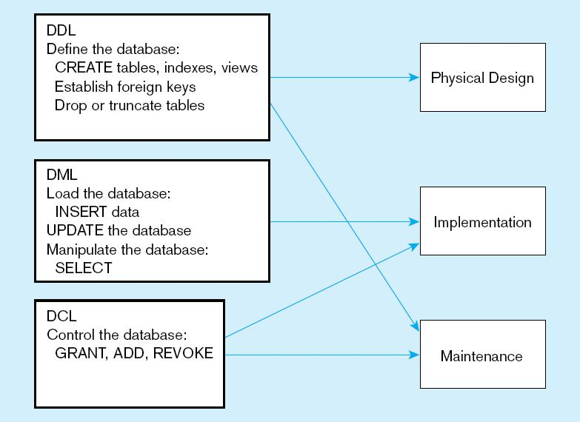
DDL, DML, DCL, and the database development process

Slide 48
CREATE TABLE
CREATE TABLE Customer
(
CustomerID int not null,
CustomerName nvarchar(25),
CustomerAddress varchar(30),
CustomerCity varchar(20),
CustomerState char(2),
CustomerPostalCode varchar(9)
CONSTRAINT Customer_PK primary key (CustomerID )
);

Slide 49

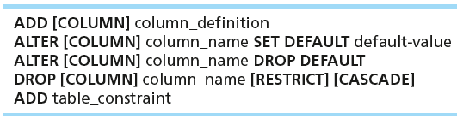
Changing Tables
ALTER TABLE statement allows you to change column specifications:
Table Actions:
Example (adding a new column with a default value):
ALTER TABLE Customer ALTER column CustomerType varchar(20)
Notes:
-- Add new column
ALTER TABLE Customer ADD CustomerType varchar(2) default ( 'Commercial')
-- Add new column
ALTER TABLE Customer ALTER column CustomerType varchar(20)

Slide 50
Creating Tables with Identity Columns
CREATE TABLE Customer
(
CustomerID int not null IDENTITY(1,1),
CustomerName nvarchar(25),
CustomerAddress varchar(30),
CustomerCity varchar(20),
CustomerState char(2),
CustomerPostalCode varchar(9)
CONSTRAINT Customer_PK primary key (CustomerID)
);
Inserting into a table does not require explicit customer ID entry or field list
INSERT INTO CUSTOMER VALUES ( ‘Contemporary Casuals’, ‘1355 S. Himes Blvd.’, ‘Gainesville’, ‘FL’, 32601);
Notes:
That’s a IBM DB2 syntax, also same syntax as Oracle 12c
Prior to Oracle 12c, Oracle used a combination of sequence and triggers.
SQL Server: Identity (1,1)
MySQL: AUTO_INCREMENT

Slide 51
ALTER TABLE
Modify table to add constraint
ALTER TABLE CUSTOMER ADD CONSTRAINT CUSTOMER_PK PRIMARY KEY (CustomerID)
Modify table to add column
ALTER TABLE Customer ADD CustomerType varchar(20)

Slide 52
Removing Tables
DROP TABLE statement allows you to remove tables from your schema:
DROP TABLE CUSTOMER

Slide 53
INSERT Statement
INSERT INTO CUSTOMER VALUES
(1, 'Contemporary Casuals', '1355 S. Himes Blvd.', 'Gainesville', 'FL', '32601', 'Commercial');
INSERT INTO Product (
[ProductID]
,[ProductDescription]
,[ProductFinish]
,[ProductStandardPrice]
,[ProductLineID])
VALUES
( 1, 'End Table','Cherry', 175,8 );

Slide 54
Delete Statement
Removes rows from a table
Delete certain rows
DELETE FROM CUSTOMER WHERE CUSTOMERSTATE = ‘MA’
Delete all rows
DELETE FROM CUSTOMER;
Another way to remove records from all table is TRUNCATE statement
Example : TRUNCATE TABLE Customer
The main difference between TRUNCATE and DELETE are:
TRUNCATE is considered a DDL, DELETE is DML
TRUNCATE doesn’t log the operation ( will cover later)

Slide 55
Delete Statement
Removes rows from a table
Delete certain rows
DELETE FROM CUSTOMER_T WHERE CUSTOMERSTATE = ‘HI’;
Delete all rows
DELETE FROM CUSTOMER;
TRUNCATE TABLE CUSTOMER (DDL)

Slide 56

Update Statement
Modifies data in existing rows

Slide 57
SELECT Statement
Used for queries on single or multiple tables
Clauses of the SELECT statement:
SELECT
List the columns (and expressions) that should be returned from the query
FROM
Indicate the table(s) or view(s) from which data will be obtained
WHERE
Indicate the conditions under which a row will be included in the result
GROUP BY
Indicate categorization of results
HAVING
Indicate the conditions under which a category (group) will be included
ORDER BY
Sorts the result according to specified criteria

Slide 58
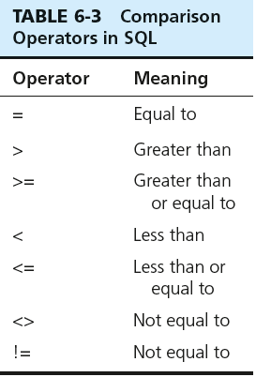

SELECT Example
Find products with standard price less than $275
Table 6-3: Comparison Operators in SQL
Notes:
Show the operators
Go back to SSMS and query the database!
What is the purpose of select clause? FROM clause? Where clause?

Slide 59
SELECT Example Using Alias
Alias is an alternative column or table name
SELECT CUST.CUSTOMERNAME AS NAME, CUST.CUSTOMERADDRESS
FROM CUSTOMER_V CUST
WHERE NAME = ‘Home Furnishings’;

Slide 60
SELECT Example Using a Function
Using the COUNT aggregate function to find totals
SELECT COUNT(*) FROM ORDERLINE_T
WHERE ORDERID = 1004;
Note: with aggregate functions you can’t have single-valued columns included in the SELECT clause, unless they are included in the GROUP BY clause

Slide 61
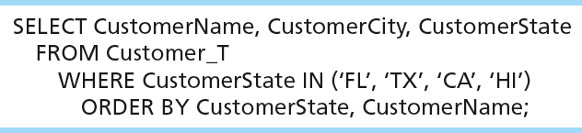
SELECT Example – Sorting Results with the ORDER BY Clause
Sort the results first by STATE, and within a state by the CUSTOMER NAME
Note: the IN operator in this example allows you to include rows whose CustomerState value is either FL, TX, CA, or HI. It is more efficient than separate OR conditions.

Slide 62
Aggregate Function syntax
SELECT expression1, expression2, ... expression_n,
aggregate_function1 (aggregate_expression),
aggregate_function2 (aggregate_expression)
FROM tables
[WHERE conditions]
GROUP BY expression1, expression2, ... expression_n
[ORDER BY expression [ ASC | DESC ]];
Notes:
Expression1 , 2 , 3 are non aggregates.
You may have more than one aggregate functions in a SELECT expression
All non aggregate expressions must included in the group by clause

Slide 63
Aggregate Functions
SUM -> summation
MIN -> to find the lowest or minimum
MAX -> to find the highest or maximum
AVG -> mean
COUNT -> how may records
Notes:
There are many others, depending on the DBMS system you are using.
STD Deviation of a population
STD Devation of a sample
VAR of Popluation
VAR of a population

Slide 64

SELECT Example– Categorizing Results Using the GROUP BY Clause
For use with aggregate functions
Scalar aggregate: single value returned from SQL query with aggregate function
Vector aggregate: multiple values returned from SQL query with aggregate function (via GROUP BY)
Note: you can use single-value fields with aggregate functions if they are included in the GROUP BY clause

Slide 65
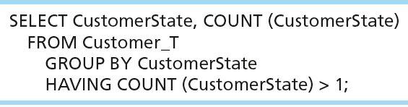
SELECT Example– Qualifying Results by Categories Using the HAVING Clause
For use with GROUP BY
Like a WHERE clause, but it operates on groups (categories), not on individual rows. Here, only those groups with total numbers greater than 1 will be included in final result.
Notes:
Where clause if to filter individual records
the having clause works on the aggregate (or combined) rows in a group by

Slide 66
SELECT DISTINCT
SELECT DISTINCT dept_id
FROM EMPLOYEE;
Results
Dept_id
500
501

Slide 67
SELECT DISTINCT in Aggregate Function
SELECT expression1, expression2, ... expression_n,
aggregate_function1 (DISTINCT aggregate_expression),
aggregate_function2 (aggregate_expression)
FROM tables
[WHERE conditions]
GROUP BY expression1, expression2, ... expression_n
[ORDER BY expression [ ASC | DESC ]];

Slide 68
Using and Defining Views
Views provide users-controlled access to tables
Can be used for reporting
Base Table–table containing the raw data
Dynamic View
A “virtual table” created dynamically upon request by a user
No data actually stored; instead data from base table made available to user
Based on SQL SELECT statement on base tables or other views
Notes:
Materialized views in Oracle, they are called Indexed views in SQL Server which are based on clustered index

Slide 69
Questions

Slide 70
4) A two-dimensional table of data is called a:
A) group.
B) set.
C) declaration.
D) relation.
Notes:
Answer: D
Diff: 1 Page Ref:157
Topic: The Relational Data Model
AACSB: Analytic Skills, Use of Information Technology
Subtopic: Relational Data Structure

Slide 71
8) A primary key that consists of more than one attribute is called a:
A) foreign key.
B) composite key.
C) multivalued key.
D) cardinal key.
Notes:
Answer: B
Diff: 2 Page Ref:157
Topic: The Relational Data Model
AACSB: Use of Information Technology
Subtopic: Relational Keys

Slide 72
17) Which of the following are anomalies that can be caused by redundancies in tables?
A) Insertion
B) Deletion
C) Modification
D) All of the above
Notes:
Answer: D
Diff: 1 Page Ref:164, 165
Topic: Integrity Constraints
AACSB: Analytic Skills, Use of Information Technology
Subtopic: Well-Structured Relations

Slide 73
True of False
59) A cascading delete removes all records in other tables associated with the record to be deleted.
Notes:
Answer: TRUE
Diff: 2 Page Ref:162
Topic: Integrity Constraints
AACSB: Use of Information Technology
Subtopic: Referential Integrity

Slide 74
18) The subtype discriminator is a composite attribute when there is a(n):
A) overlap rule.
B) disjoint rule.
C) partial specialization.
D) full specialization.
Notes:
Answer: A
Diff: 2 Page Ref:125
Topic: Specifying Constraints in Supertype/Subtype Relationships
AACSB: Analytic Skills, Use of Information Technology
Subtopic: Defining Subtype/Supertype Hierarchies

Slide 75
20) In a supertype/subtype hierarchy, subtypes that are lower in the hierarchy inherit attributes from not only their immediate supertype but from all ________ in the hierarchy.
A) subtypes
B) supertypes
C) constraints
D) dimensions
Notes:
Answer: B
Diff: 2 Page Ref:127
Topic: Supertype/Subtype Hierarchies
AACSB: Reflective Thinking
Subtopic: Summary of Supertype/Subtype Hierarchies

Slide 76
True or False
36) A completeness constraint may specify that each entity of the supertype must be a member of some subtype in the relationship.
Notes:
Answer: TRUE
Diff: 1 Page Ref:121
Topic: Specifying Constraints in Supertype/Subtype Relationships
AACSB: Use of Information Technology
Subtopic: Specifying Completeness Constraints

Slide 77
10) In which data model would a code TABLE appear?
A) Conceptual
B) Logical
C) Physical
D) Data layout
Notes:
Answer: C
Diff: 2 Page Ref:213
Topic: Designing Fields
AACSB: Use of Information Technology
Subtopic: Coding Techniques

Slide 78
16) Distributing the rows of data into separate files is called:
A) normalization.
B) horizontal partitioning.
C) vertical partitioning.
D) file allocation.
Notes:
Answer: B
Diff: 1 Page Ref:218
Topic: Denormalizing and Partitioning Data
AACSB: Analytic Skills, Use of Information Technology
Subtopic: Partitioning

Slide 79
37) A rule of thumb for choosing indexes is to:
A) be careful indexing attributes that may be null.
B) index each primary key of each table.
C) use an index when there is variety in attribute values.
D) all of the above.
Notes:
Answer: D
Diff: 1 Page Ref:230
Topic: Using and Selecting Indexes
AACSB: Analytic Skills, Use of Information Technology

